Slide 1
Create Engaging Presentations with PowerPoint and Sway Peter Wu Principal Software Engineer

Slide 2
Ways of Learning
Visual/Spatial 75%
30%
45%
25%
Words 70%

Slide 3

Introduction to Sway

Slide 4
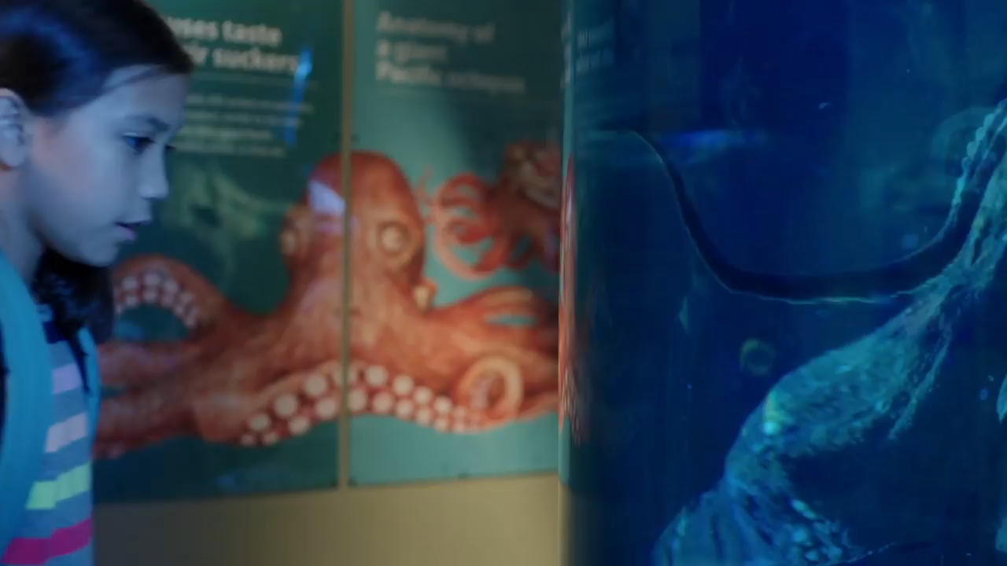

Introduction to Sway: Video

Slide 5
Sway: A New Way to Present Your Ideas
Gorgeous and dynamic design
Assemble on any device
Automatically formatted for the device
Media rich
Easy to share and collaborate

Slide 6

PowerPoint

Slide 7
PowerPoint: A Familiar Tool With Amazing New Capabilities
Designer
Screen Recording
Summary Zoom
Slide Show Recording
Surface Pen Integration
Closed Captions
Icons
SVG
Morph
New Chart Types
3D Models

Slide 8
Accessibility Built In
Keyboard Accessibility
Screen Reader Support
Office Sounds
Magnifier Support
High Contrast Mode
Accessible PDF Output
Alt Text
Closed Captions
Accessibility Checker
Accessibility View
Training Videos

Slide 9
Accessibility Compliance
Compliant with all applicable requirements including Revised Section 508, EN 301 549, and WCAG 2.0
Conformance documents published and kept up-to-date
Using Department of Homeland Security Trusted Tester Program to validate compliance

Slide 10
Comparing Sway and PowerPoint
Sway | PowerPoint
Accessible
Collaborate and share in the cloud
Media rich
Automatic layout and format | Precise control of layout and format
Adapts to different devices | Same across devices
 | 2D drawing canvas, tables, charts, diagrams, ink
 | Tools for presenting and recording
 | Works offline

Slide 11
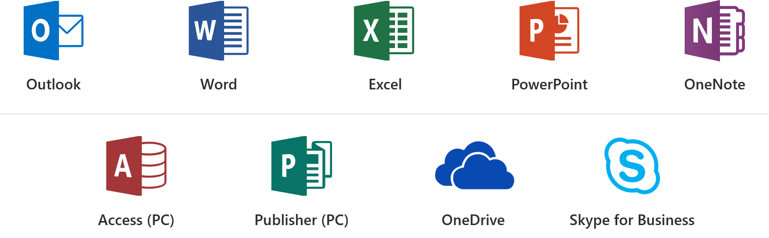
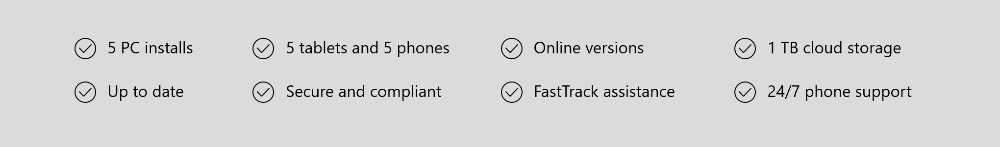
Office 365 ProPlus Overview

Slide 12
Office 365 Sessions at CSUN ATC
3/21 11am: What’s New in Microsoft Office 365
3/22 8am: Strategies to Make your IT Applications More Accessible
3/22 11am: Create Inclusive Classrooms with Microsoft Education
3/22 1.20pm: Microsoft Reading, Writing and Learning Tools
3/22 3.20pm: Excel 101 Tips and Tricks
3/22 4.20pm: Easily create accessible content with Office 365
3/23 9am: Modernization of IT with SharePoint Accessibility
3/23 11am: Create Engaging and Accessible Presentations with PowerPoint and Sway
3/23 2.20pm: How I used Microsoft OneNote to Manage a Medical Crisis
3/23 4.20pm: Software Architecture in Office 365 for Exposing Accessible Content
Notes:
Holding slide during presentation Q&A

Slide 13
Resource Links
Microsoft at CSUN
Aka.ms/CSUN2018
Answer Desk for Accessibility Support
aka.ms/eDAD
Microsoft Accessibility Overview
Microsoft.com/Accessibility
Notes:
Holding slide during presentation Q&A

Slide 14
We want to hear from you.
Connect with us in person today or anytime through our support and feedback channels.
Disability Answer Desk for phone/chat/ASL Help: Aka.ms/AccessibilitySupport
User voice Forum for Accessibility Feedback: Aka.ms/AccessibilityFeedback
Notes:
Holding slide during presentation Q&A

